Slide 1
Computer Engineering 12 Class 4 – Lab 2
Instructor: Yuhong Liu
Office: Banan 324 F
Email: yhliu@scu.edu
Tel: 408-551-3513

Slide 2
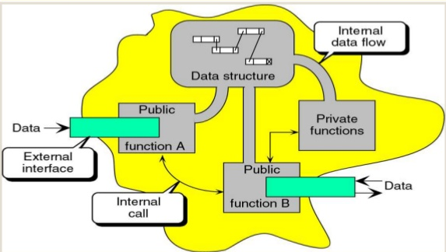
Abstract Data Type
Encapsulate the data and the operation on the data, and then hide them from the user.
Declaration of data
Declaration of operations
Encapsulation of data and operations.

Slide 3
Lab 2

Slide 4
A New ADT: Set
A set: an unordered collection of distinct elements.
Example: Students registered for a class is an example of a set. We care who’s in it, not really the order in which they signed up.
We are going to build a SET ADT in Lab 2
Order doesn’t matter
No repetition

Slide 5
Who Needs a Set
There are two example applications that need a set
Application 1 (unique.c) with two input files and the second one is optional. Read in all the distinct words in a given file and insert these words in a set.
Print out the total amount of unique words;
If the second file is given then all words in the second file are deleted from the set; and the count is printed;
Print out each of these unique words.
2. Application 2: use a set to maintain a collection of words that occur an odd number of times in a given file. (parity.c)
Both of these two applications need a set to store the words occurring in a given file!

Slide 6
ADT: SET - An Illustration
Code given:
unique.c
ADT: SET
parity.c
Code to implement

Slide 7
What Interfaces to Provide
The outside program (i.e. applications) should be able to
Create a set
Insert an element into the set
Count how many elements are currently in this set
Delete an element from the set
Search whether a specific element is in the set
Allocate and return an array of elements in the set pointed to by a pointer
Destroy the set

Slide 8
ADT: SET - An Illustration
ADT: SET
createSet
unique.c
addElement
numElements
parity.c
removeElement
search (private)
findElement
getElements
destroySet
(Public)

Slide 9
Implementing a SET
How to store elements of a set in memory? Data structure
Here are some options: array, linked list, tree, graph, …
=> Array !

Slide 10
ADT: SET - An Illustration
ADT: SET
createSet
unique.c
addElement
Data structure: Array
numElements
removeElement
Search (private)
parity.c
findElement
getElements
destroySet

Slide 11
ADT - SET Assignment
You will be given the set.h which defines the following interfaces for this ADT
SET *createSet(int maxElts);
bool addElement(SET *sp, char *elt);
int numElements(SET *sp);
bool removeElement(SET *sp, char *elt);
char *findElement(SET *sp, char *elt);
char **getElements(SET *sp);
void destroySet(SET *sp);
This SET handles strings!
You are implementing just this ADT ... not the test programs or the header
Two week project
First week: you will finish an unsorted implementation

Slide 12
ADT - SET Assignment
main program: unique.c, parity.c
your implementations: unsorted.c, sorted.c
you must test all two programs against unsorted.c in the first week
you must finish the sorted implementation for the second week
the TAs will help you if you don’t quite understand, e.g., how to work with the different files

Slide 13
Implementing a SET Using Array
Pre-knowledge:
Store string elements in an array
Dynamically sized array
Structure

Slide 14
A Simpler Case - int
In the assignment, you are required to implement the set for strings.
However, strings are relatively hard to understand;
So let’s use a simpler case – int as an example! Then figure out how to implement the case of string.

Slide 15
Store string elements in an array
Pre-knowledge

Slide 16
How to Store Integers in an Array
Array a
0
2
3
88
5
…
….
90
int a[100];
How to store strings in an array in C?

Slide 17
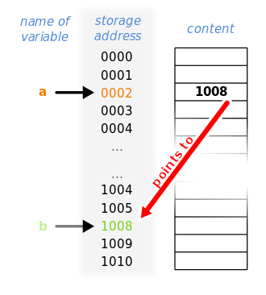
Pointer
In computer science, a pointer is a programming language object, whose value refers to (or "points to") another value stored elsewhere in the computer memory using its memory address. A pointer references a location in memory, and obtaining the value stored at that location is known as dereferencing the pointer.
int b = 3; (b is allocated at address 1008)
int* a = &b; (let pointer a point to the address of b)
a =? *a = ?

Slide 18
String in C – Character Array
Character Array
char * p0
m | a | n | g | o | \0
char * p1
b | a | n | a | n | a | \0
Refer to the character array through a character pointer: char *
e.g. the pointer name is p0. The value of p0 is 1008, which is the address of the character array of “mango”.

Slide 19
How to Store Strings in an Array
Character arrays
Array a
A | p | p | l | e | \0
P0
P1
P2
P3
P4
P5
….
b | a | n | a | n | a | \0
……..
m | a | n | g | o | \0
Use array a to store character pointers: char *
How to declare array a?
Char* a[100] ;

Slide 20
The First Function
SET *createSet(int maxElts);
The maximum number of elements in the SET
Note that createSet() requires a parameter that indicates the max # of elements that we will need to store.
Problem: In our project, array length is not known in advance and will be passed as a parameter maxElts.
If they say 10,000 and then use 10,001 ... It’s not your problem, they broke the contract.
How to implement a dynamically sized array?

Slide 21
Dynamically Sized Array
Pre-knowledge 2

Slide 22
Dynamically Sized Array
In C, how do we implement a dynamically sized array?
we implement a statically sized array (that doesn’t change) by doing: int a[10];
Can we do int a[n]?

Slide 23
Dynamically Sized Array
In C we implement a dynamically allocated array by using a pointer:
int *a;
This initially points to garbage, until you do a memory allocation using a function that allocates memory ...
We then need to explicitly allocate the memory using malloc()
a = malloc(sizeof(int)*n);
assert(a!=NULL)
The assert.h header file of the C Standard Library provides a macro called assert which can be used to verify assumptions made by the program and print a diagnostic message if this assumption is false.

Slide 24
Assert
An assertion specifies that a program satisfies certain conditions at particular points in its execution.
Common uses
Pointers are not NULL.
Indices and size values are non-negative and less than a known limit.
Ex:
p is a pointer: assert(p != NULL);
we want to access the i_th element of an array a, which has size of n: assert(?)
Make sure to test the condition before the usage of the variable.

Slide 25
How about String?
A dynamically allocated array of strings
char **a;
a = malloc(sizeof(char *)*n);
assert(a!=NULL);

Slide 26
Implementing a SET
We will implement our set using an array. We need therefore to keep track of three things:
1. the address of the array
2. the length of the array
3. the number of elements in the array
What’s the difference between 2 and 3?
How to track three things together?
=> structure!

Slide 27
Structure
Pre-knowledge 3

Slide 28
Structure in C
Concept
A structure is a collection of one or more variables, possibly of different types, grouped together under a single name for convenient handling.
E.g. struct mystruct {
int a;
int b;
char c;
};
For students who are not familiar with structures, please check our textbook “The C Programming Language” Chapter 6.

Slide 29
A Simpler Case - int
Recall that we need to track three things as
1. the address of the array
2. the length of the array
3. the number of elements in the array
Let’s construct the structure
struct set {
int count;
int length;
char **data;
};

Slide 30
Implementing a String SET
SET.c
#include <assert.h> // for error detection
#include “set.h”
typedef struct set {
int count;
int length;
char **data;
} SET;
Refer to set.h for the declaration of all the pubic functions.

Slide 31
The Data Structure of a SET
a struct
a string array
Character arrays
Count | Length | Char** Data
Char *
Char *
Char *
Char *
Char *
Char *
A | p | p | l | e | \0
0
1
b | a | n | a | n | a | \0
SET* sp
……..
count -1
length-1
m | a | n | g | o | \0
How to initialize this data structure?

Slide 32
Function 1: createSET
// draw memory state diagram alongside the instructions
SET *createSet(int maxElts)
{
SET *sp;
sp = malloc(sizeof(SET));
assert(sp != NULL);
sp->count = 0;
sp->length = maxElts;
sp->data = malloc(sizeof(char*)*maxElts);
assert(sp ->data!= NULL);
return sp;
}

